Slide 1
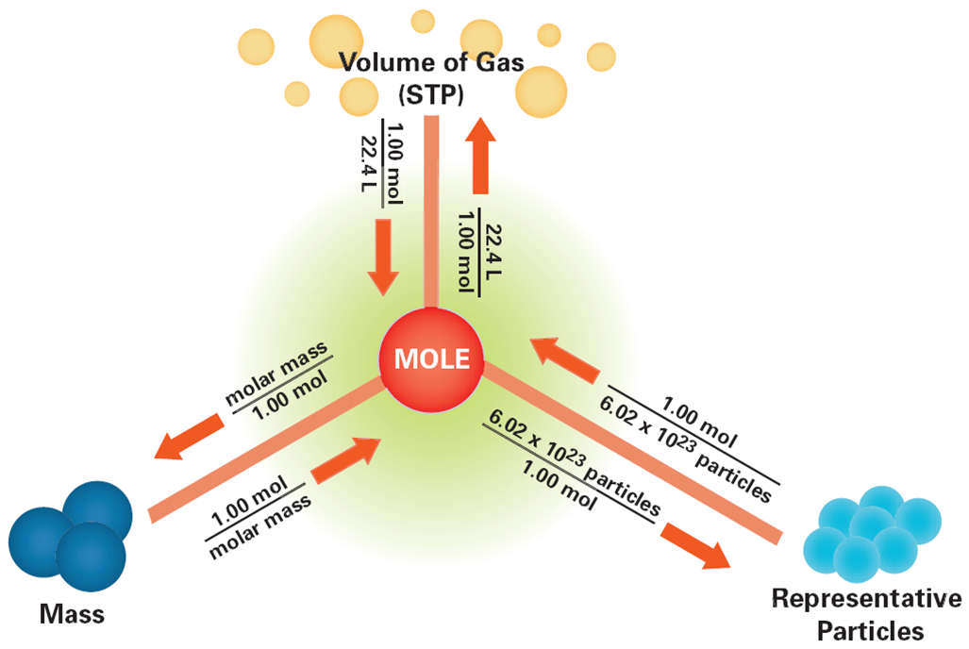

Slide 3
unit
given
unit
requested

